Slide 1

Phishing Awareness Training
Protect Your Organization from Cyber Threats
Name: Shreyas R
Email Threats
Fake Websites
Social Engineering
Best Practices
Cybersecurity Training Series

Slide 2









Table of Contents
1
Introduction to phishing threats
8
Interactive quiz
2
Phishing statistics and trends
9
What to do if phished
3
Recognizing phishing emails
10
Reporting & incident response
4
Identifying fake websites
11
Multi-factor authentication
5
Social engineering tactics
12
Password security
6
Real attack case studies
13
Company policies
7
Security best practices
14
Key takeaways
Cybersecurity Training Series

Slide 3



What is Phishing? Introduction to Email Threats
Definition
Phishing is a form of social engineering attack that uses deceptive emails, messages, or websites to trick users into revealing sensitive information or installing malware. Attackers masquerade as trusted entities to manipulate victims.
Anatomy of a Phishing Attack
1. Deceptive Message Sent
Why Human Vigilance is Essential
Email filters miss sophisticated phishing attempts Attackers constantly evolve their tactics
Technology alone cannot identify all social engineering Human judgment is the last line of defense
Trained employees are your organization's security perimeter
2. User Interacts with Content
3. Credentials/Data Compromised
4. Attack Executed & Expanded
68% of data breaches involve the human element
Source: Verizon Data Breach Investigations Report 2024
64%
of businesses report BEC attacks
$4.8M
average cost per phishing breach
94%
of malware delivered via email
Cybersecurity Training Series

Slide 4

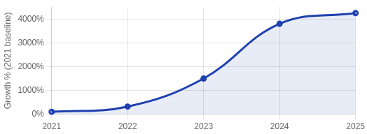



Phishing by the Numbers: Current Statistics & Trends
Alarming Growth in Phishing
Phishing attacks have exploded in recent years, particularly with the rise of AI tools. The overall volume of phishing has reached
unprecedented levels.
Phishing Attack Growth 2021-2025
4,151% Increase
in phishing attacks since ChatGPT's launch in 2022 (SlashNext)
Financial Impact
$4.88M average cost per phishing breach (IBM 2024)
$150,000 average loss per BEC incident
$1 trillion+ stolen globally by scammers in past year Cost increased by 10% from 2023-2024
Source: Hoxhunt Phishing Trends Report 2025
Most Targeted Industries
1. Finance & Insurance
3. Mining & Oil/Gas
5. Retail Trade
2. Manufacturing
4. Healthcare
Emerging Phishing Trends 2025
AI-driven phishing emails with perfect grammar
QR code phishing (quishing) up 25% year-over-year 80% of phishing sites now use HTTPS
Multi-channel attacks across email, messaging, and social Phishing-as-a-Service kits up 50% on dark web
Microsoft
Most
impersonated
DocuSign 2nd most targeted
HR Depts 3rd most targeted
Cybersecurity Training Series

Slide 5








How to Recognize a Phishing Email
Phishing emails try to trick you into revealing sensitive information or installing malware. Learning to spot these 10 warning signs can protect you and your organization from falling victim to these attacks.
Unfamiliar Tone or Greeting
Generic greetings like "Dear User" or unexpected formal/informal tones from familiar senders
Grammar and Spelling Errors
Poor grammar, misspelled words, and awkward phrasing that legitimate organizations would catch
Suspicious URLs & Domains
Mismatched or slightly altered domain names (paypa1.com vs paypal.com) or strange URL paths
Urgency or Threats
Messages creating panic with "Act Now!" or "Account Suspension Imminent" to pressure quick action
Suspicious Attachments
Unexpected file attachments, especially with extensions like .exe,
.zip, or .scr
Unusual Requests
Requests that deviate from normal processes or ask you to bypass standard security procedures
Short & Ambiguous Content
Vague messages with minimal details trying to pique curiosity or create confusion
Unsolicited Communication
Messages about accounts, prizes, or issues you did not sign up for or initiate
Requests for Sensitive Data
Asking for credentials, financial details, or personal information via email
Too Good To Be True
Promises of prizes, money, or exclusive offers that seem unrealistic or overly generous
Always verify suspicious emails through a different channel (phone call, official website) before taking action
Hover over links (don't click) to preview URLs and check for suspicious domains
Cybersecurity Training Series

Slide 6



Identifying Fake Websites and Domain Red Flags
Phishing websites are designed to mimic legitimate sites, but they contain subtle differences. Use these 5 key methods to identify fake websites and protect your personal and company information.
1. Check the URL
2. Assess the Content
3. Verify Ownership
Look for the padlock icon and HTTPS Check for misspellings (e.g., amazom.com)
Watch for numbers replacing letters (amaz0n.com)
Beware of subdomains (amazon.fake- site.com)
Hover over links before clicking them
Look for poor grammar and spelling errors Check for low-quality images and logos
Be suspicious of unprofessional design Verify contact information is complete Compare with known legitimate sites
Use WHOIS lookup to check domain age New domains (< 1 year) are suspicious Check if owner matches expected company Verify legitimate contact information
Check SSL certificate information
Red flag example: "Your account has been compromise, please login immediate"
Red flag example: Domain registered yesterday in a foreign country
Red flag example: paypa1.com (using "1" instead of "l")
4. Read Online Reviews
5. Payment Methods
Remember:
If something feels suspicious, it probably is. Trust your instincts and verify before providing any personal information or credentials.
Search "[site name] + scam" in Google Check trusted review sources
Look for consistent negative reports
Be wary of sites with no online presence Verify business on Better Business Bureau
Be wary if only bank transfer is offered Legitimate sites accept credit cards
Look for secure payment options (PayPal) Check for security seals on checkout pages Verify encryption during payment process
Always report suspicious websites to your IT security team.
Red flag example: Multiple users reporting stolen credit card info
Red flag example: Site requesting payment via wire transfer only

Slide 7








Social Engineering Tactics Used in Attacks
Social engineering exploits human psychology rather than technical vulnerabilities. Attackers manipulate victims into breaking security procedures through these common tactics:
Phishing
Spear Phishing
Mass emails mimicking legitimate sources to steal credentials or install malware.
Targeted phishing customized for specific individuals using personal information.
Pretexting
Creating a fabricated scenario to extract information. The attacker usually impersonates co-workers, police, bank officials, or other trusted individuals.
Vishing
Smishing
Voice phishing using phone calls to trick victims into revealing information.
SMS phishing using text messages with malicious links.
Baiting
Using a false promise to pique a victim's curiosity or greed. Examples include infected USB drives left in parking lots or "free movie download" links.
Psychological Manipulation Techniques
Quid Pro Quo
Offering a service or benefit in exchange for information or assistance. Common example: attackers impersonating IT support staff offering "help" in exchange for login credentials.
Urgency
Forcing quick decisions without time to verify
Authority
Impersonating figures of power or influence
Likability
Building rapport to exploit trust
Fear
Creating anxiety to provoke action
Even security-conscious individuals can be manipulated with the right social engineering approach
Cybersecurity Training Series

Slide 8






Case Studies: Real-World Phishing Attacks
Change Healthcare Attack
Pepco Group Attack
Date: February 2024
Impact: Over 100 million users affected
Vector: Compromised login credentials harvested via phishing
Date: February 2024
Impact: €15.5 million financial loss
Vector: AI-crafted phishing emails for fraudulent transfers
Attackers infiltrated systems using phished credentials, disrupting critical healthcare operations including billing, insurance claims, and pharmacy services nationwide.
Attackers used advanced AI tools to create convincing messages without errors, mirroring previous communication tone to
facilitate fraudulent money transfers.
Key Lesson:
Implement robust MFA for all critical systems and thoroughly train staff on credential security.
Key Lesson:
Implement multi-person verification for all financial transfers above a threshold amount.
StrelaStealer Campaign
Starbucks Campaign
Date: June-August 2024
Impact: 100+ U.S. & European organizations
Vector: ZIP attachments with malicious JavaScript
Date: October 2024
Impact: 900+ reports in two weeks
Vector: Emails offering free Coffee Lovers box
Targeted emails contained ZIP attachments with JavaScript files that deployed StrelaStealer to extract credentials from Microsoft Outlook and Mozilla Thunderbird.
Scam emails offered a free Starbucks Coffee box with links to steal personal and financial data. Earlier versions contained the ZeuS banking Trojan.
Key Lesson:
Block suspicious attachments and implement advanced email scanning solutions.
Key Lesson:
Be skeptical of "too good to be true" offers; legitimate companies rarely request sensitive information via email.
Common Themes & Key Takeaways
Implement robust multi-factor authentication for all critical systems
Regular training on evolving phishing techniques is essential
Establish verification protocols for financial transactions
Implement advanced email filtering and scanning
Create clear reporting channels for suspicious communications
Develop rapid incident response plans for when breaches occur
Cybersecurity Training Series

Slide 9







Cybersecurity Best Practices & Prevention Tips
Essential Security Measures
Use strong, unique passwords - At least 12 characters with a mix of uppercase, lowercase, numbers, and special characters. Never reuse passwords across accounts.
Password & Authentication Best Practices
Enable Multi-Factor Authentication (MFA) - Add an additional layer of security beyond just passwords. Use authenticator apps rather than SMS when possible.
Use: P@$sw0rd!2925#
Use a password manager Enable MFA on all accounts
Avoid: password123
Reusing passwords Sharing credentials
Keep software updated - Regularly update operating systems, applications, and browsers to patch security vulnerabilities.
Practice safe browsing - Verify website URLs before entering credentials, look for HTTPS, and be cautious with downloads.
Security Maintenance Checklist
Install antivirus/antimalware
Enable automatic updates
Always Verify Before Taking Action
Contact the sender through a different channel if a request seems suspicious
Hover over links to preview URLs before clicking Verify payment requests through official channels When in doubt, report to IT security
Backup critical data
Use VPN on public Wi-Fi
Lock devices when unattended
Use privacy browser settings
80%
of breaches prevented by basic security hygiene
99%
MFA protection against common attacks
24hrs
max time to install critical
security patches
Cybersecurity Training Series

Slide 10

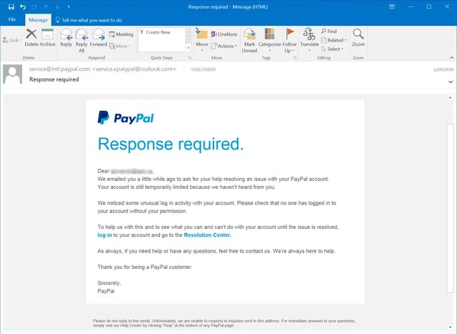




Interactive Quiz: Spot the Phish!
From: Paypal Service
<service.verification@paypa1-support.com>
To: you@company.com
Subject: URGENT: Your PayPal account has been limited
Scenario Question:
Is this email legitimate or a phishing attempt? Select the correct answer and identify why.
Aug 8,
10:42 AM
A
Legitimate PayPal email
This is a standard security notification from PayPal.
B
Phishing - Suspicious sender domain
The email uses "paypa1-support.com" (with the number 1) instead of paypal.com.
Dear Valued Customer,
We have noticed unusual activity on your PayPal account. As a security measure, we have temporarily limited your account access until you verify your information.
Please click the button below to verify your information and restore full access to your account:
Phishing - Creates urgency
The email uses urgent language and threats to pressure you into action.
C
D
Phishing - All of the above
Contains multiple red flags: suspicious domain, urgent language, and requesting account verification.
Verify Account Now
If you do not verify your account within 24 hours, your account will be suspended.
Thank you,
PayPal Security Team
Quiz tip: Always check the sender's email address and look for pressure tactics before taking action on emails.
Cybersecurity Training Series

Slide 11



If You Fall Victim to Phishing: What to Do Next
Immediate Action Plan
If you suspect you've fallen victim to a phishing attack, quick action can minimize damage and prevent further compromise. Follow these steps immediately:
Disconnect Your Device
Disconnect from the internet immediately to prevent malware from spreading or data from being transmitted to attackers.
Change Your Passwords
Change passwords for all potentially affected accounts immediately, using a clean, uncompromised device.
Report the Incident
Alert your IT security team or help desk immediately. Speed is critical to contain the breach.
Scan for Malware
Run a comprehensive anti-malware scan to identify and remove any malicious software.
Critical Response Timeline
F₁ir_{h}st Hour: Critical Window
Take immediate actions to disconnect, report, and secure accounts. This period is crucial for limiting damage.
F₂i₄rs_{h}t 24 Hours: Damage Control
Work with IT on forensics, notify affected parties, monitor accounts for suspicious activity.
N₇₂ex_{h}t 72 Hours: Recovery
Implement additional security measures, review detection capabilities, participate in post-incident review.
60%
of data theft occurs within hours of a breach
82%
breach cost reduction with fast incident response
Never ignore a potential phishing incident
Early reporting can prevent organization-wide compromise. Most companies have a 60-minute critical response window to minimize damage.

Slide 12



How to Report Suspicious Emails & Incident Response
Reporting Suspicious Emails
Use the Phishing Report Button in your email client Don't forward suspicious emails to colleagues
Never reply to the suspected phishing email If you've already clicked, report immediately
Include what made you suspicious in your report
SOC Response Process
1. Threat Analysis
Verify legitimacy and identify threat type
2. Containment
Block similar emails and malicious domains
Escalation Procedures
Initial report through phishing button
IT Security team initial assessment (30 min SLA)
SOC team investigates confirmed threats
Emergency response for critical incidents
Threat containment and remediation
3. Impact Assessment
Identify affected users and systems
4. Remediation & Recovery
Clean affected systems and restore operations
86%
reduction in phishing incidents
39s
fastest 5% report time
$3.2M
average savings per
avoided breach
Time is critical in phishing response
The average dwell time for a phishing attack is reduced by 60% with prompt employee reporting
Cybersecurity Training Series

Slide 13



Multi-Factor Authentication (MFA) & Password Security
What is Multi-Factor Authentication?
MFA requires two or more verification methods from different categories:
Strong Password Guidelines
12+ characters
Dictionary words
Something you know - password or PIN
Something you have - security key or authenticator app
Something you are - fingerprint or facial recognition
Mix of characters
Personal info
Unique per account
Password reuse
Password Managers
A secure way to store, generate, and manage your passwords across all accounts:
MFA Methods Comparison
Generates strong, unique passwords for each account
Auto-fills credentials securely across devices Alerts you to compromised or reused passwords Only requires remembering one master password Protects against keyloggers and phishing sites
SMS Codes
Basic
Email Codes
Better
Auth Apps
Strong
Security Keys
Best
MFA can block 99.9% of automated attacks
Source: Microsoft Security Intelligence Report
Take Action Today:
Enable MFA on all work and personal accounts Install a reputable password manager
Update weak passwords to strong, unique ones Set up biometric authentication where available

Slide 14


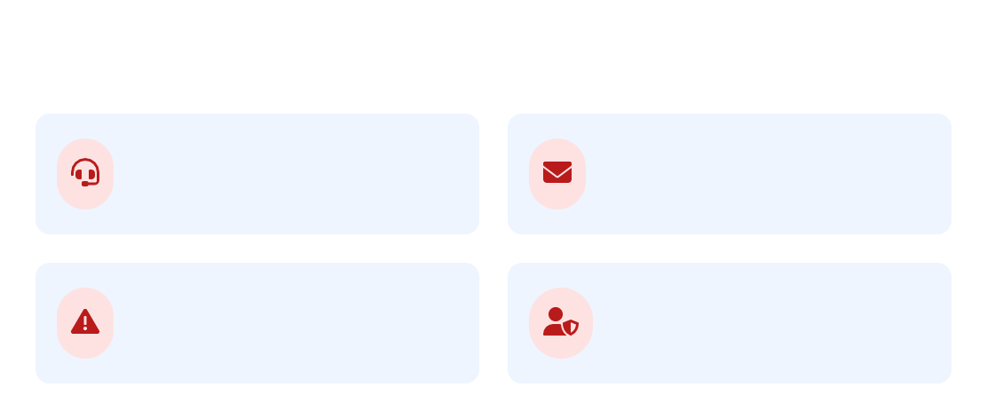
Company Policies & Security Guidelines
Corporate Security Policies
Data Classification Policy: Guidelines for handling sensitive, confidential, and public data
Acceptable Use Policy: Rules for proper use of company IT resources
Email Security Policy: Guidelines for safe email communication and attachment handling
Remote Work Security: Security requirements when working outside the office
Incident Response Plan: Procedures for reporting and addressing security incidents
Your Security Responsibilities
Report all suspicious emails to the security team immediately Complete security awareness training annually
Use approved company systems for all business communications Follow clean desk policy for sensitive information
Lock your computer (Win+L / Cmd+Ctrl+Q) when leaving your desk
Policy documents are available on the company intranet
Visit the Security Portal for the complete policy library and latest updates
How to Access Policy Documents
Company Intranet > Departments > IT Security Security Policy Handbook (PDF available offline)
Security Team Contact Information
Security Helpdesk
Extension: 5555
Report Phishing
security@company.com
Urgent Incidents
1-800-555-SECURITY
CISO Office
ciso@company.com
In Case of Security Emergency
If you suspect your account has been compromised or your device infected:
Disconnect from the network immediately
Call the Security Incident Response Team (SIRT)
Do not shut down your computer
Document what happened

Slide 15


Summary & Key Takeaways
Remember These Key Points
Phishing attacks are constantly evolving and becoming more sophisticated with AI and QR codes
Always verify sender addresses, check for grammar errors, and be suspicious of urgency tactics
Inspect URLs before clicking - look for HTTPS and verify legitimate domains
Never provide sensitive information in response to an unsolicited request
Report suspicious emails immediately using proper channels
Organizations with trained employees experience 86% fewer phishing incidents
Your Action Items
Enable Multi-Factor Authentication
Set up MFA on all your accounts, especially for email and financial services
Use a Password Manager
Create strong, unique passwords for each of your accounts
Keep Software Updated
Enable automatic updates for your devices and applications
Report Suspicious Activity
Use the phishing report button or contact IT Security immediately
Security Is Everyone's Responsibility
Your vigilance protects not just yourself, but your entire organization
Resources
Cybersecurity Training Series

